Slide 1


Setup and C1C1 analysis
Department of Physics, Shandong University
Chengxin Liao
liaocx@ihep.ac.cn
Feb, Wed 26, 2025

Slide 2
Setup
First thing you need to do is check the computing platform introduction and familiar with linux, more detail can find here http://afsapply.ihep.ac.cn/cchelp/en/ Linux tool: https://missing.csail.mit.edu/2020/
Second thing is modify your own computing environment 1. create a file called .bashrc and .bash_profile at you home dir, full path is here: /afs/ihep.ac.cn/users/c/chengxinliao more detail: https://www.digitalocean.com/community/tutorials/bashrc-file-in-linux
2. your work dir at: /publicfs/atlas/atlasnew/SUSY/users/chengxinliao (This is my work dir🤓)
3. you can cd to work dir can creat a file called setup_initiate.sh
In short is a file can autoexcute when users log in
Here should be your username
I think every rookie in computer field have to see this
1
Chengxin Liao
IHEP SUSY Meeting

Slide 3
Setup
Some tools need to know: based on we have LLM, program can be easy for us, but we still need have basic cognition about these tool 1. C/Cpp/python, just a tool, as a rookie, you probably don’t need to know the detail, but you have to build a frame about it
2. Latex: I think I don’t need to introduce it 3. GNU make & CMake: maybe you don’t need to know how to write, but at least you need to know why we need this file 4. Git & Github: code version !!!(Introduce in Missing semester, website link at page 1 in this sildes) 5. VPN(25105 19981 30693 36947 36825 20010 26159 20160 20040) Great class I recommend:
UCB CS61a(python and structure): https://cs61a.org Stanford CS106L(Cpp): https://web.stanford.edu/class/cs106l/ UCB CS189(ML): https://eecs189.org
Actually I don’t want to put too much burden on you, so just get a superficial understanding will be cool
😈
Hope you have a wonderful journey in these courses
1
Chengxin Liao
IHEP SUSY Meeting

Slide 4
Details about setup file
.bashrc full file can check: /afs/ihep.ac.cn/users/c/chengxinliao/.bashrc
export PATH=/cvmfs/common.ihep.ac.cn/software/hepjob/bin:$PATH export PATH=/cvmfs/container.ihep.ac.cn/bin:$PATH export PATH=$PATH:/afs/ihep.ac.cn/users/c/chengxinliao/.local/bin
export C_INCLUDE_PATH=/publicfs/atlas/atlasnew/SUSY/users/chengxinliao/MiniAnalysis/include:/publicfs/atlas/atlasnew/SUSY/users/chengxinliao/MiniAnalysis/src:$C_INCLUDE_PATH export CPLUS_INCLUDE_PATH=/publicfs/atlas/atlasnew/SUSY/users/chengxinliao/MiniAnalysis/include:/publicfs/atlas/atlasnew/SUSY/users/chengxinliao/MiniAnalysis/src:$CPULS_INCLUDE_PATH export ATLAS_LOCAL_ROOT_BASE=/cvmfs/atlas.cern.ch/repo/ATLASLocalRootBase alias setupATLAS='source ${ATLAS_LOCAL_ROOT_BASE}/user/atlasLocalSetup.sh’ alias setupATLAS6='source ${ATLAS_LOCAL_ROOT_BASE}/user/atlasLocalSetup.sh -c slc6’ source /publicfs/atlas/atlasnew/SUSY/users/chengxinliao/setup_initiate.sh lsetup cmake alias liao='cd /publicfs/atlas/atlasnew/SUSY/users/chengxinliao'
C and Cpp include/lib path
Help you cd to work dir, remember change name
1
Chengxin Liao
IHEP SUSY Meeting

Slide 5
Details about setup file
setup_initiate.sh full detail can check: /publicfs/atlas/atlasnew/SUSY/users/chengxinliao/setup_initiate.sh setupATLAS lsetup "views LCG_102b_ATLAS_22 x86_64-centos9-gcc11-opt” unset PYTHONHOME export Dir_MiniAnalysis="/publicfs/atlas/atlasnew/SUSY/users/chengxinliao/MiniAnalysis/” export Dir_BOOST="/cvmfs/sft.cern.ch/lcg/releases/Boost/1.72.0-7bbce/x86_64-centos7-gcc8-opt” .bash_profile source ~/.bashrc
1
Chengxin Liao
IHEP SUSY Meeting

Slide 6
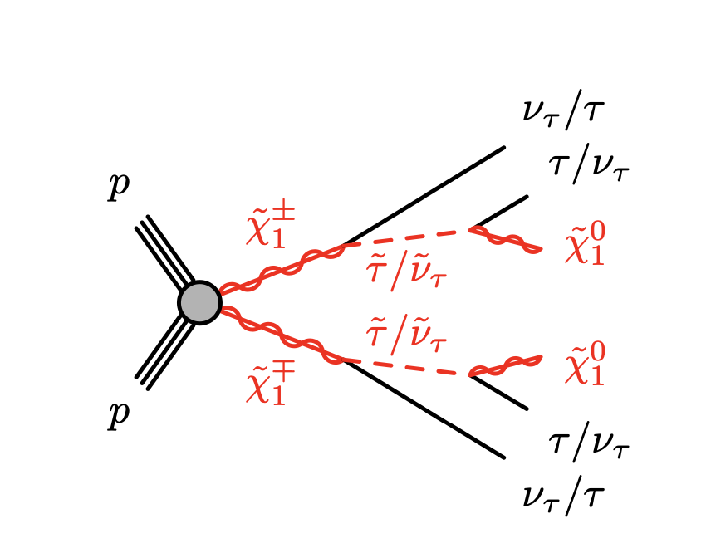
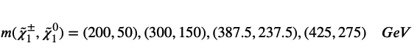
About C1C1 analysis
process of analysis pre-selection -> MC_modeling check -> kinematic distribution -> CutCount and define signal region–> bkg estimation and error analysis(data-driven, ABCD method)
selecte powerful var to separate sig and bkg
== 2 medium tau(OS) b-jet veto Z/H veto(M_tautau) > 120GeV asymmetric di-tau trigger MET < 150GeV
Signal choose:
1
Chengxin Liao
IHEP SUSY Meeting

Slide 7
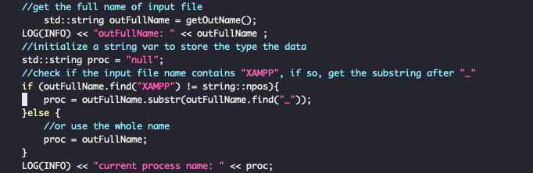
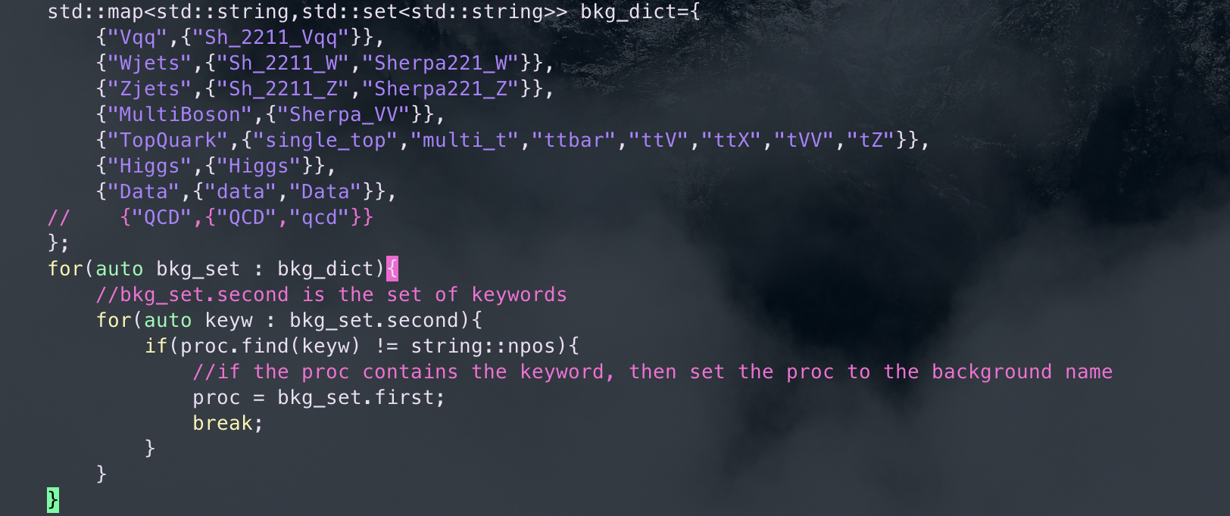
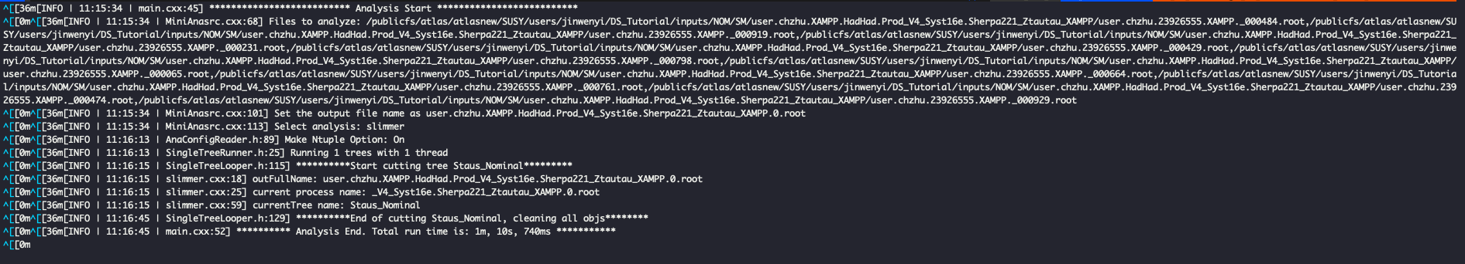
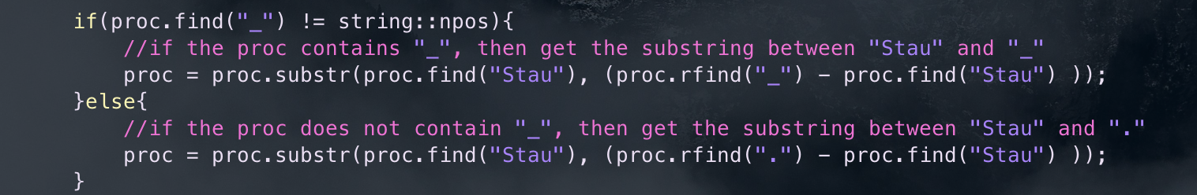
slimmer
Code can be find at /publicfs/atlas/atlasnew/SUSY/users/chengxinliao/Run2-C1C1/easycode/slimmer.cxx slimmer actually just a code that you can apply cut
Process the name of file, if you don’t get it, can check the log file
Loading bkg sample and signal
In the output of slimmer, the log file
1
Chengxin Liao
IHEP SUSY Meeting

Slide 8
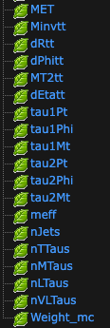
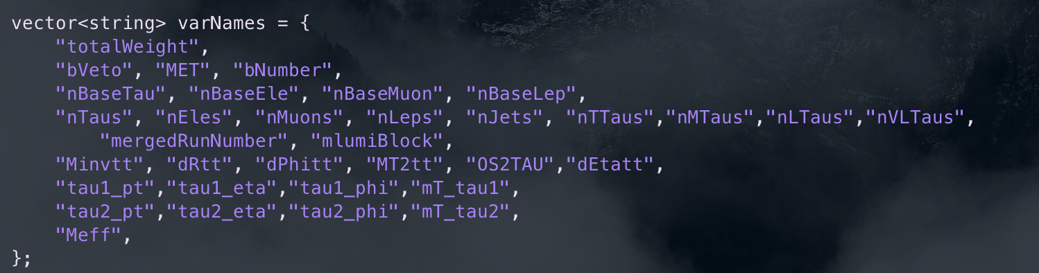
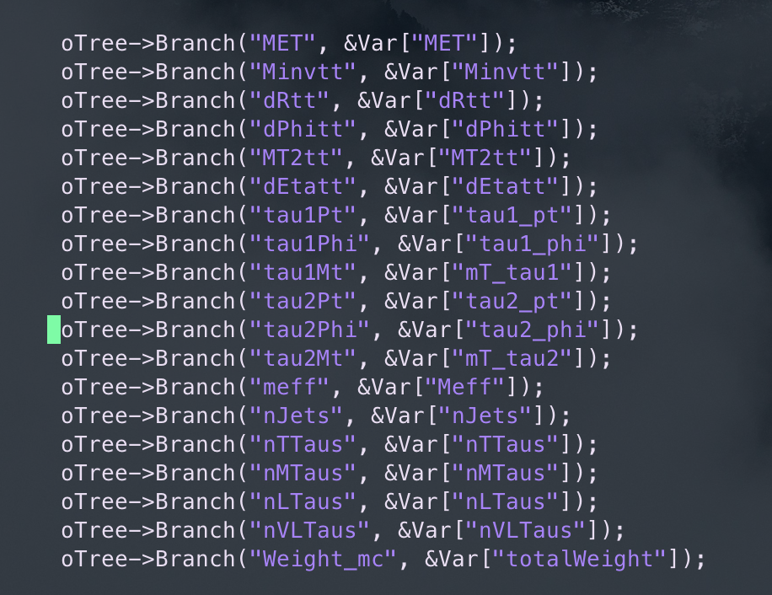
slimmer
Here set the input vars, which must can be find in branch
generate new branch in the root file of result
1
Chengxin Liao
IHEP SUSY Meeting

Slide 9
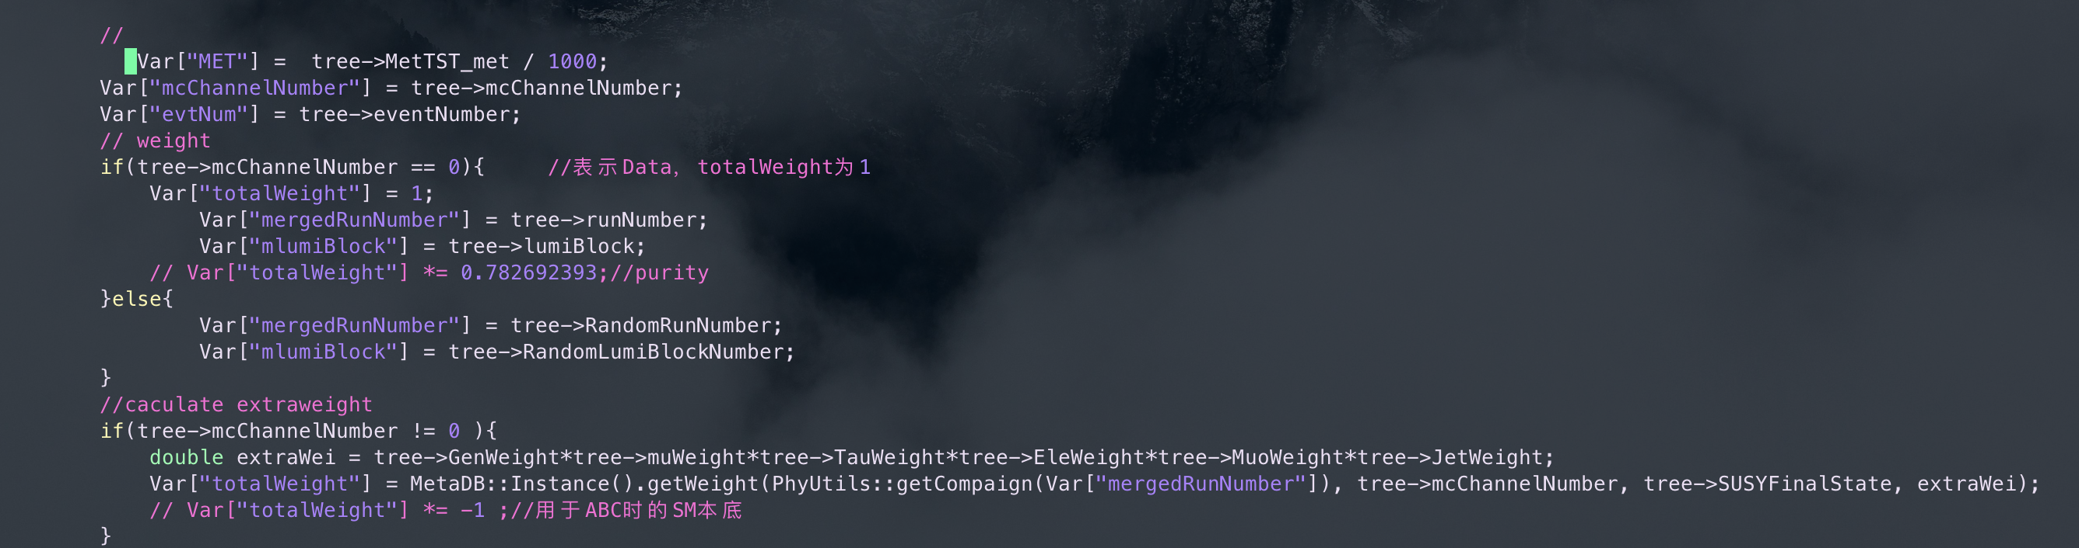
slimmer
Create the branch and Calculate the var you gone put into branch
1
Chengxin Liao
IHEP SUSY Meeting

Slide 10
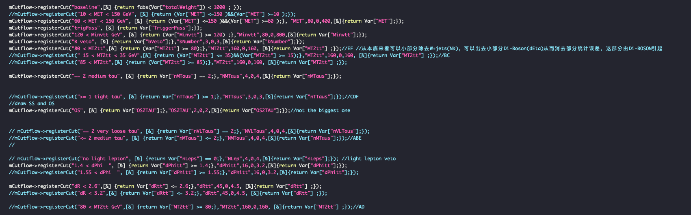
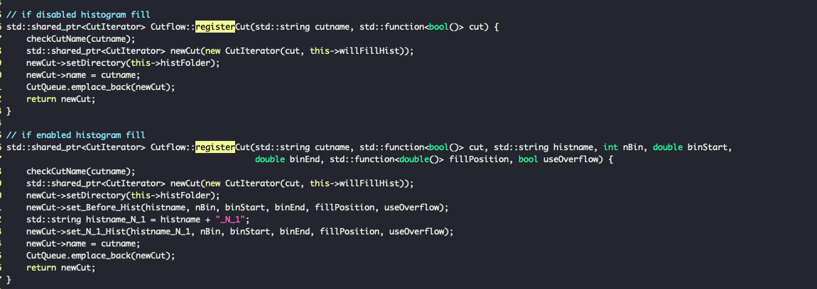
slimmer
About add Cut
registerCut function definition at: /publicfs/atlas/atlasnew/SUSY/users/chengxinliao/MiniAnalysis/src/Cutflow.cxx
First definition
Second definition
First definition will return the N plot Second definition will return the N plot and N-1 plot
1
Chengxin Liao
IHEP SUSY Meeting

Slide 11
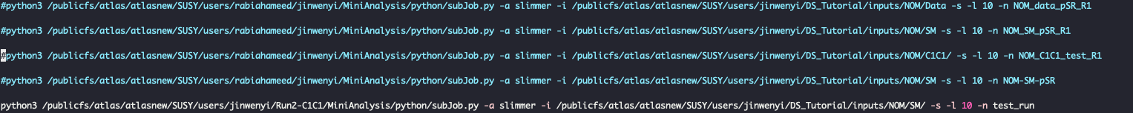
slimmer
About run :
Please ref the code of wenyi in run.sh
subJob.py is a scripts help you submit job -a means analysis -I means input dir -n means output dir other argument can check the subJob.py
1
Chengxin Liao
IHEP SUSY Meeting

Slide 12
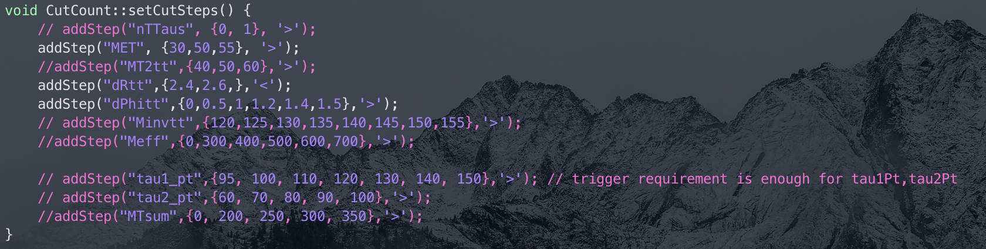
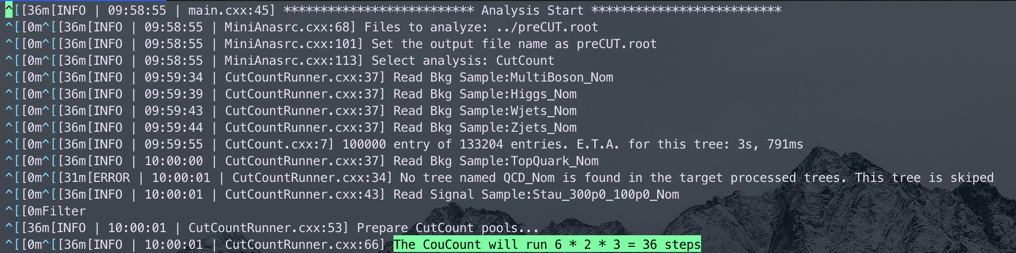
CutCount
Full code address: /publicfs/atlas/atlasnew/SUSY/users/chengxinliao/Run2-C1C1/CutCount
Method Principle: CutCount is a method to define your signal region, it can calculate the significance and yields of different cut combination, below setting is combination of input
MET > 30 dRtt < 2.4 dPhitt > 0.5
……..
More details can check MiniAnalysis/include/CutCountRunner.h
36 combinations based on operator you choose
Grid setting I suggest ref wenyi’s code and fine tuning
1
Chengxin Liao
IHEP SUSY Meeting

Slide 13
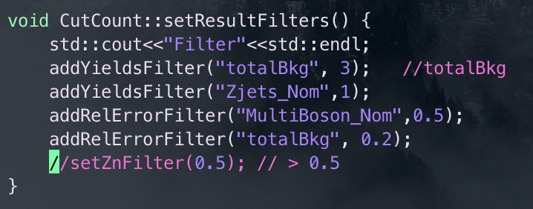
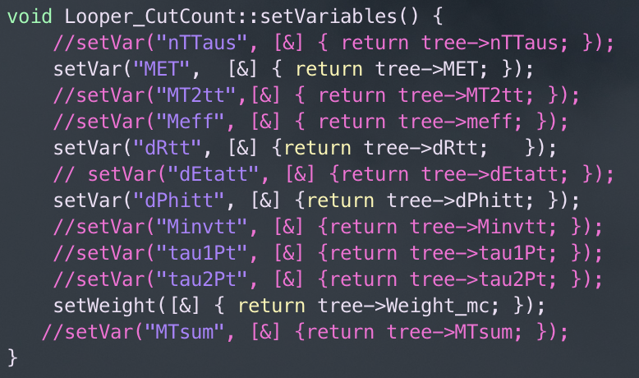
CutCount
You also can add the filter to your result
Before you start to set cut, you have to told complier where can find the var
So, maybe for now, you already familiar with structure of CutCount Let’s try to run it
🗣️
1
Chengxin Liao
IHEP SUSY Meeting

Slide 14
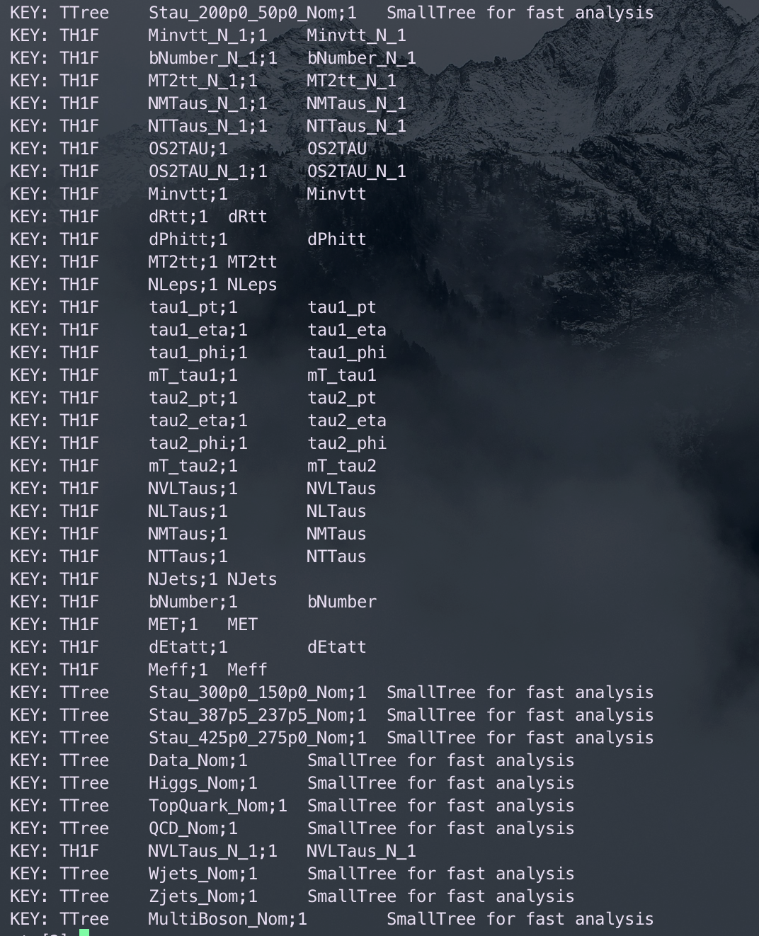
CutCount
Before start to run, thers are some file we need to prepare
preCUT.root contain the result of your pre-selection
Here is your result after passing pre-selection
You can merge them with hadd command more detail about hadd please check here https://root.cern/doc/v632/hadd_8cxx.html
Please try to merge these file and get your own preCUT.root acctully that’s the only file you need to prepare
….
1
Chengxin Liao
IHEP SUSY Meeting

Slide 15
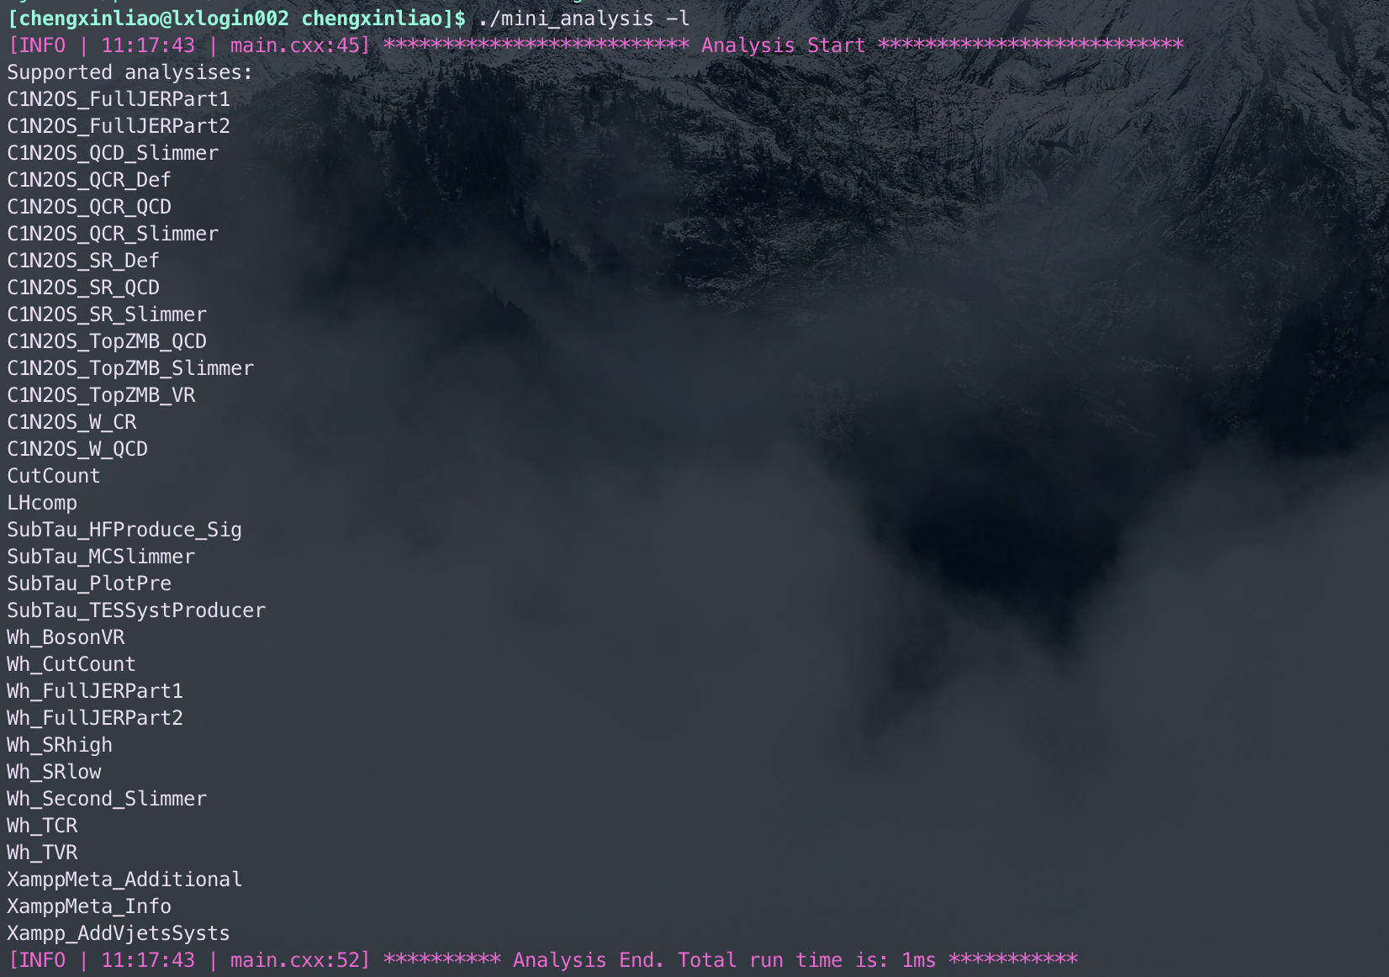
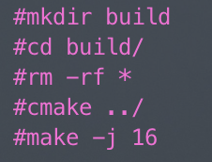
CutCount
Then you can complie the file manully or by running subJOB.sh file after you complie with no error, you will get a file called mini_analysis in build dir, and if you already learn something about CMake, you will how to handle it. But if you still not, please please check setup page!!!
subJOB.sh also contain the cmake step which is simple if you already cmake manully, please comment these lines
BTW, remember delete the run folder before you run, or change the output folder in case there is a warning, because your output folder alread exist
1
Chengxin Liao
IHEP SUSY Meeting

Slide 16
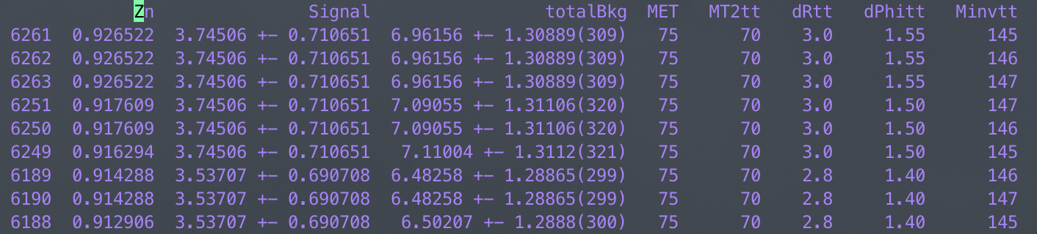
CutCount
Just use hep_sub to submit you job to computing platform, then you can see that
cutResult.csv contain the raw result based on you cut, and end.csv will show the topZn cut combination
I suggest that sig and bkg yields need to large than 3, and bkg uncertainty is less thann 20% then use the Cut you choose to slimmer.cxx and check the N-1 distribution to see if the result can meet you requirement
1
Chengxin Liao
IHEP SUSY Meeting

